Slide 1
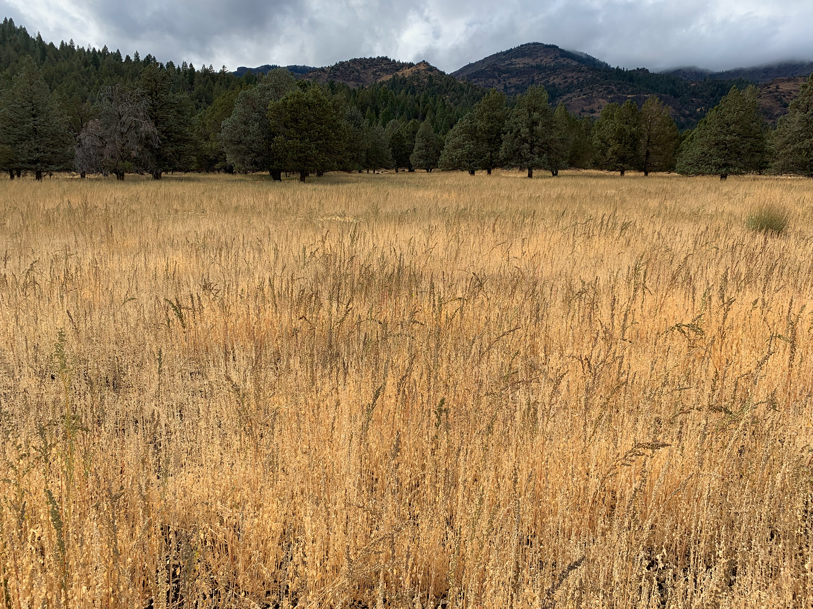

The Genome of Chenopodium berlandieri
Thomas Kerby
Brigham Young University

Slide 2

Background on Quinoa
Quinoa is a highly nutritious food
High in lysine, calcium, phosphorus, and iron
Recognized by the UN in 2013 for its potential
Not well suited to many climates including most of the U.S.
By Source (WP:NFCC#4), Fair use, https://en.wikipedia.org/w/index.php?curid=39021220
"While no single food can supply all the essential life sustaining nutrients, quinoa comes as close as any other in the plant or animal kingdom"
- NASA technical paper 3422

Slide 3
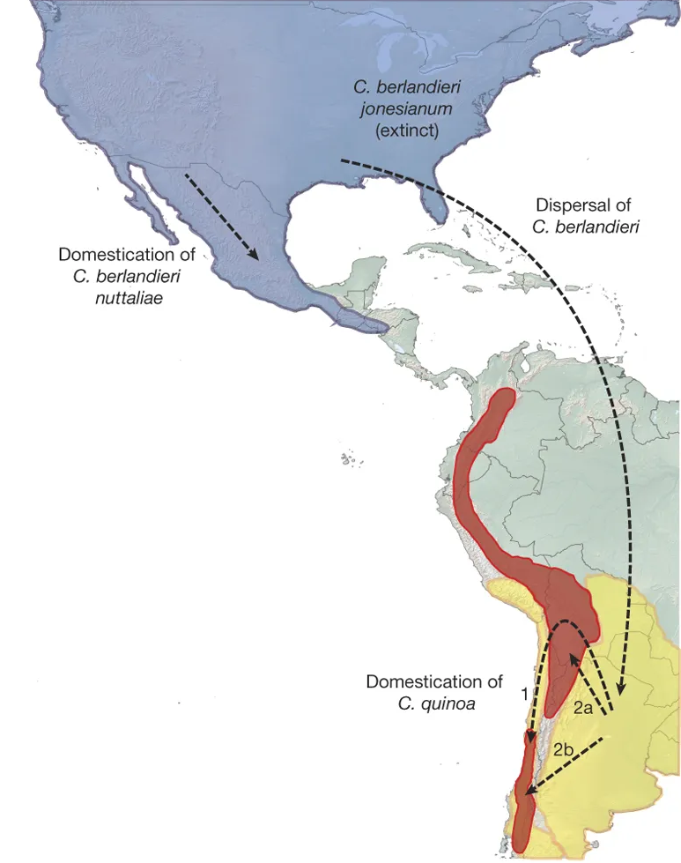
Genetic Evolution
X
AA
BB
Ancestral Tetraploid
AA
BB .
C. berlandieri – N. America
C. hircinum – S. America
C. quinoa – S. America

Slide 4
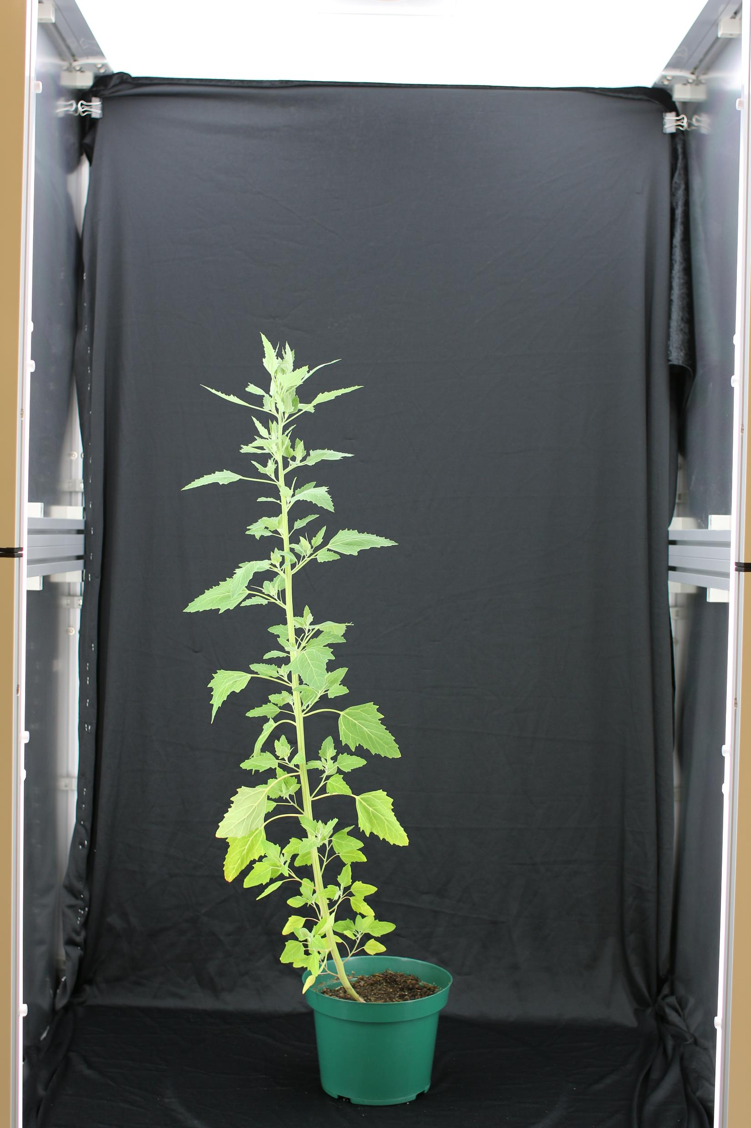
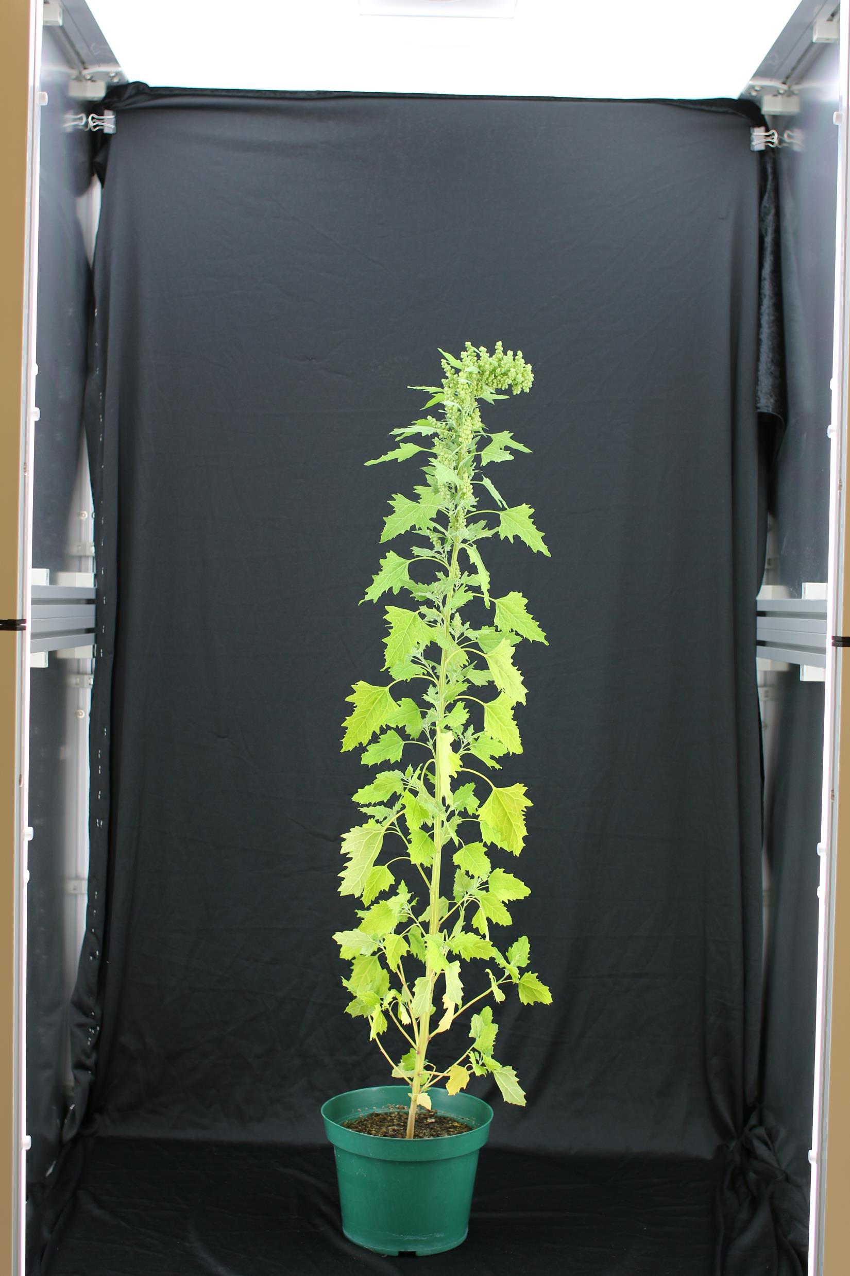
C. berlandieri vs
C. quinoa
Form fertile hybrids together
Interest in C. berlandieri
C. berlandieri
C. quinoa
Notes:
Fertile Crossings

Slide 5
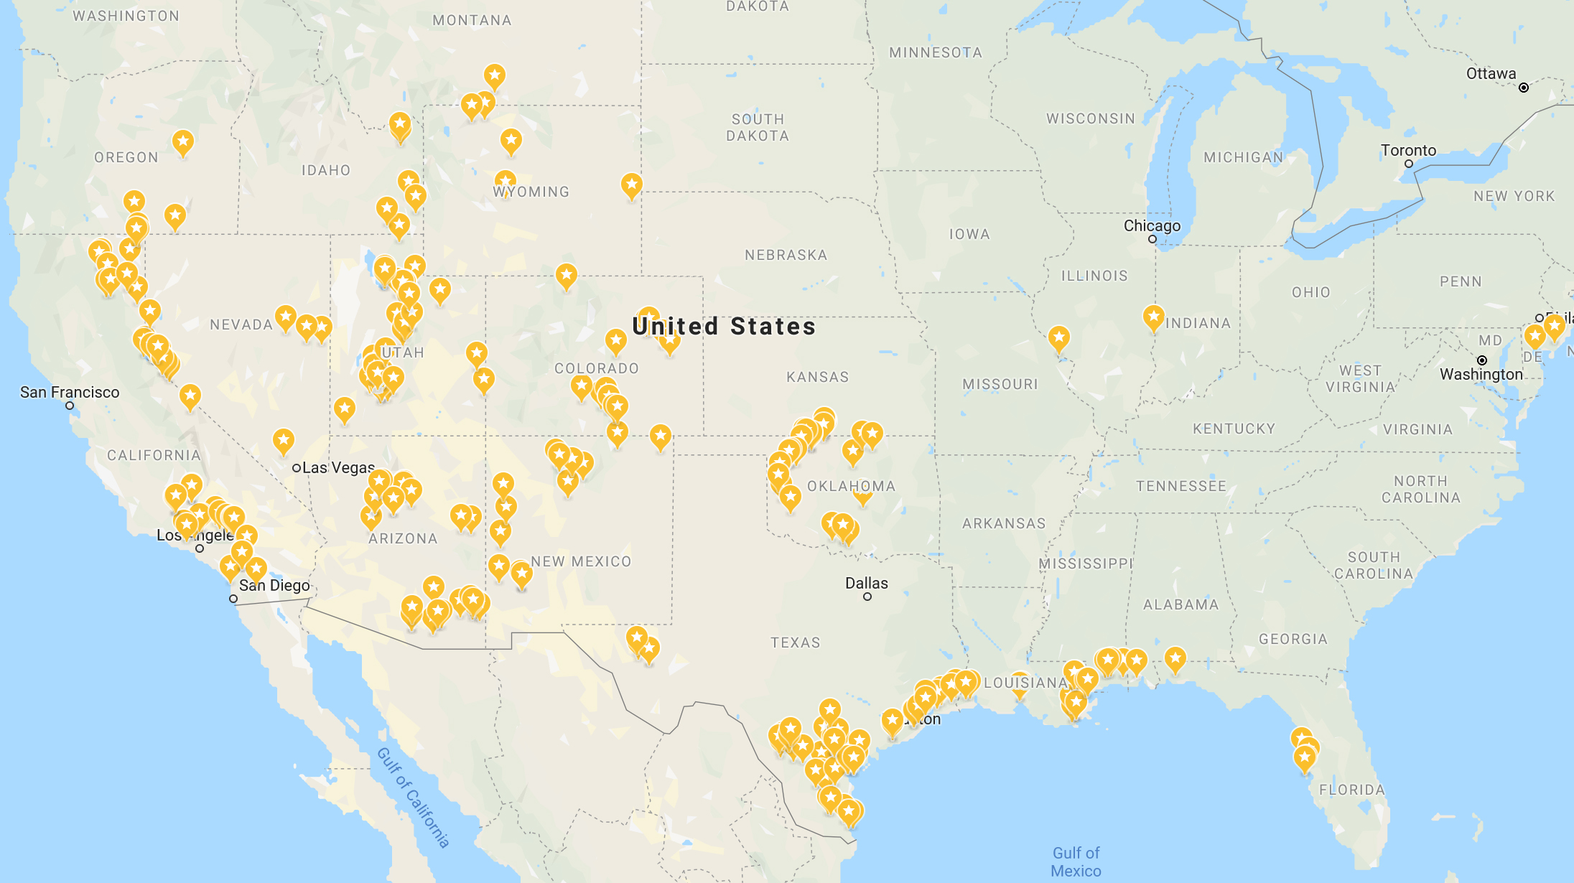
Map of C. berlandieri Sampling Locations
Notes:
Fertile Crossings

Slide 6

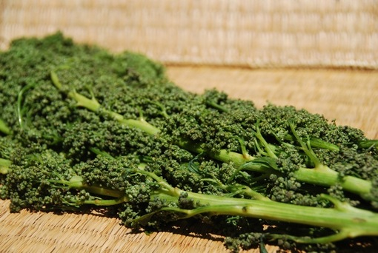
Why Sequence Huauzontle?
Cultivated variety of C. berlandieri subsp. nuttaliae
Is an important food source in regions of Mexico
Is adapted to the climate in N. America
Notes:
Can also mention uses of chia roja and jonesianum

Slide 7
DNA Sequencing
Cell Number | Total Bases | Mean (Kb) | N50 (Kb)
1 | 8.2 | 17.2 | 29.5
2 | 10.5 | 18.2 | 30.2
3 | 8.9 | 11.2 | 18.9
4 | 10.4 | 14.3 | 24.2
5 | 9.2 | 12.2 | 20.9
6 | 11.0 | 14.4 | 24.3
7 | 9.8 | 15.0 | 25.6
8 | 10.2 | 14.3 | 24.2
Total: | 78.2 | 16.4 | 23.3
Coverage = 58X ~1.35GB
Sample from Mexico
Grown using hydroponics
Dark treated (48 hours)
High molecular weight extraction using Qiagen kit
PacBio Sequel

Slide 8
Assembly
Number of contigs | 1,194
Total size of contigs | 1,295.4 Mb
Longest contig | 25.6 Mb
Mean contig size | 1.1 Mb
N50 contig length | 4.9 Mb
Assembled with Canu 1.8
Polished twice using Arrow with PacBio reads
Polished again using Pilon and 40X Illumina reads

Slide 9
Scaffolding
Number of scaffolds | 339
Total size of scaffolds | 1,295.5 Mb
Longest scaffold | 91.0 Mb
Mean scaffold size | 3.8 Mb
N50 scaffold length | 70.1 Mb
Number of contigs | 1,194
Number of contigs in scaffolds | 873
Number of contigs not in scaffolds | 321
Percentage of assembly in scaffolds | 98.20%
Assembly sent to Phase Genomics for scaffolding
In vivo HiC

Slide 10
Pre vs Post Scaffolding Stats
 | Pre-Scaffolding | Post-Scaffolding
Total size of scaffolds | 1,295.4 Mb | 1,295.4 Mb
Longest scaffold | 25.6 Mb | 91.0 Mb
Mean scaffold size | 1.1 Mb | 3.8 Mb
N50 scaffold length | 4.9 Mb | 70.1 Mb

Slide 11
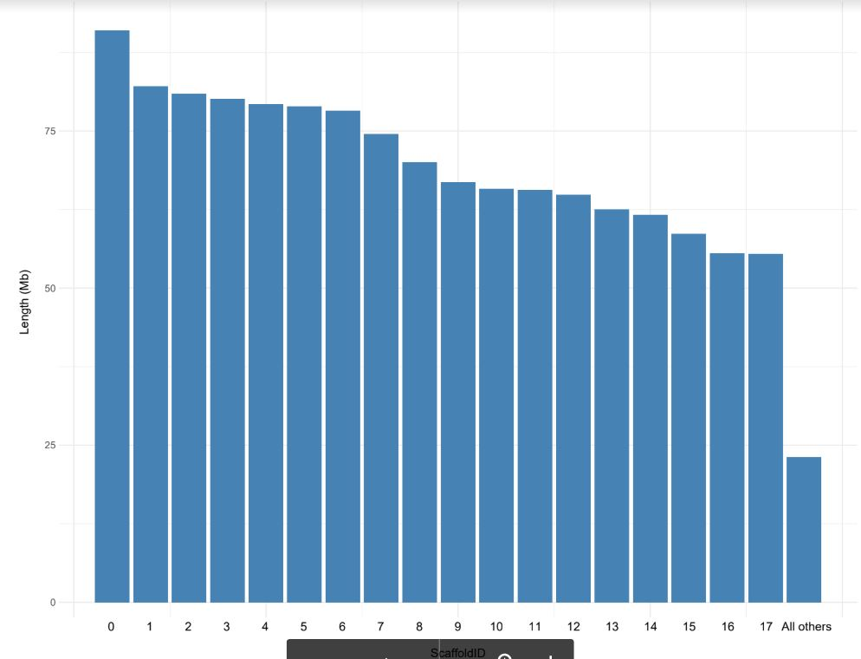
Results – Chromosome Structure
C. berlandieri is a tetraploid and is 2n = 4x = 36
First 18 bars are the chromosomes
Last bar is the cumulative size of the other scaffolds

Slide 12
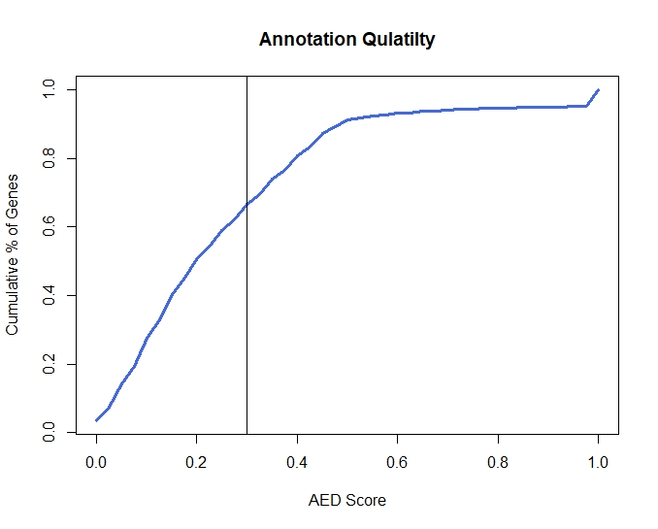
Results – Annotation
Annotated with MAKER
RNASeq evidence from 4 tissues:
Flowers
Leaves
Seedlings
Stems
66,919 Genes

Slide 13
Results – BUSCO
 | Genome |  |  | Transcript
 | Percentage | Quantity |  | Percentage | Quantity
Complete BUSCOs | 97.7% | 1343 |  | 97.3% | 1337
Complete and single-copy BUSCOs | 17.0% | 234 |  | 22.0% | 302
Complete and duplicated BUSCOs | 80.7% | 1109 |  | 75.3% | 1035
Fragmented BUSCOs | 0.3% | 4 |  | 2.0% | 27
Missing BUSCOs | 2.0% | 28 |  | 0.7% | 11
Total BUSCO groups searched | 100.0% | 1375 |  | 100.0% | 1375

Slide 14
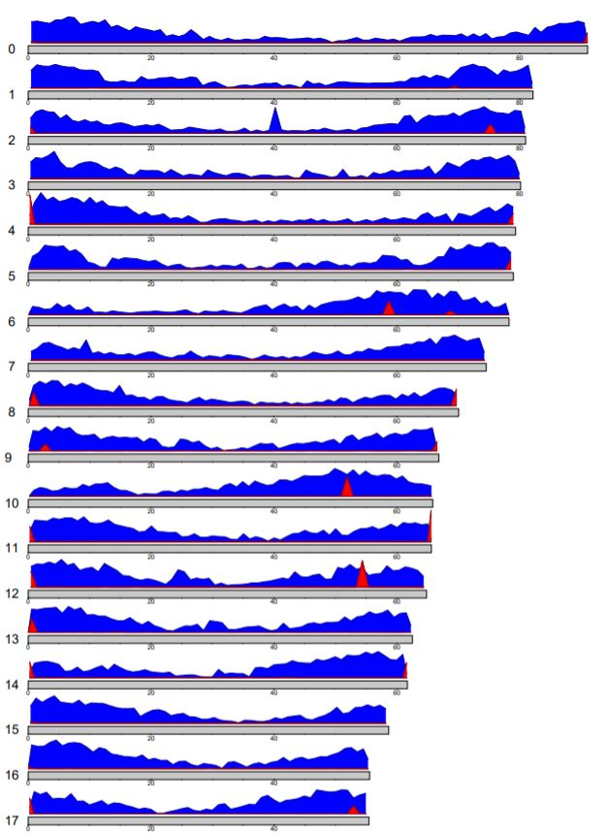
Results – Genome Structure
Blue represents gene density
Red represents telomeres
Interesting points in scaffolds 2, 6, 10, and 12

Slide 15
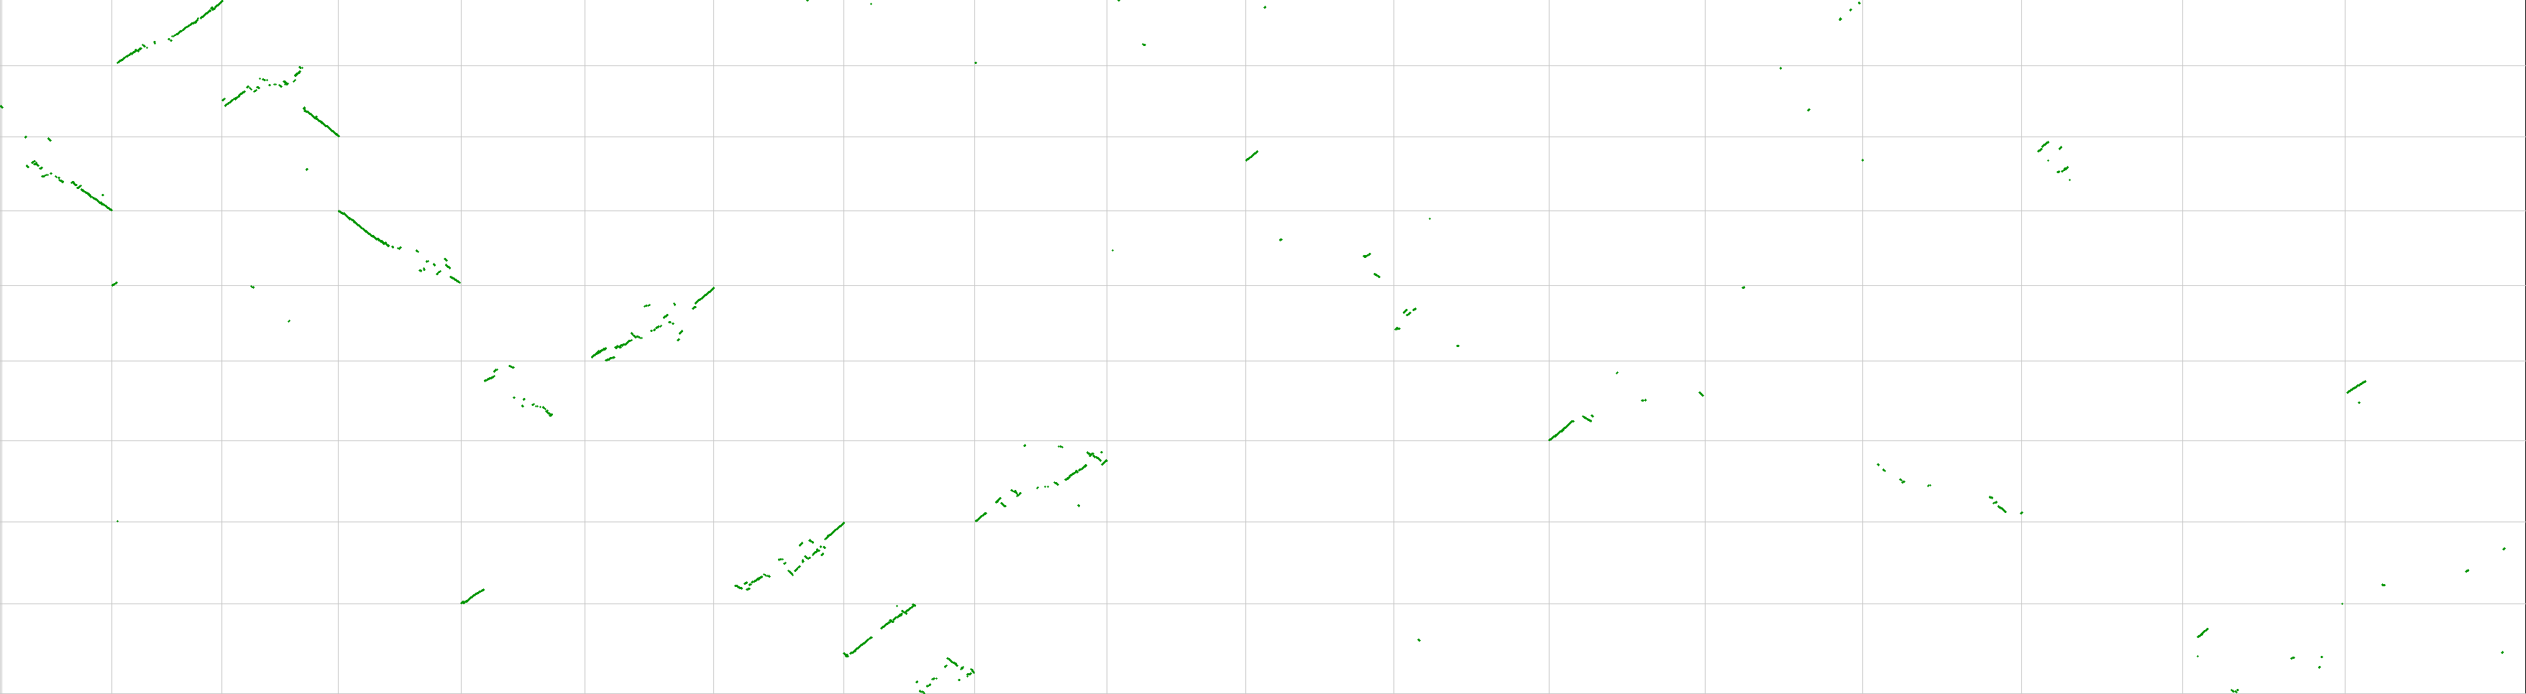
Synteny with C. pallidicaule
AA
BB
AA
0 1 2 3 4 5 6 7 8
17 16 15 14 13 12 11 10 9 8 7 6 5 4 3 2 1 0
C. pallidicaule matches up with the first part of C. berlandieri genome better than the second part
Average size of chromosome is smaller in the first part of the C. berlandieri genome than the second part
We will call this the AA part of the genome

Slide 16
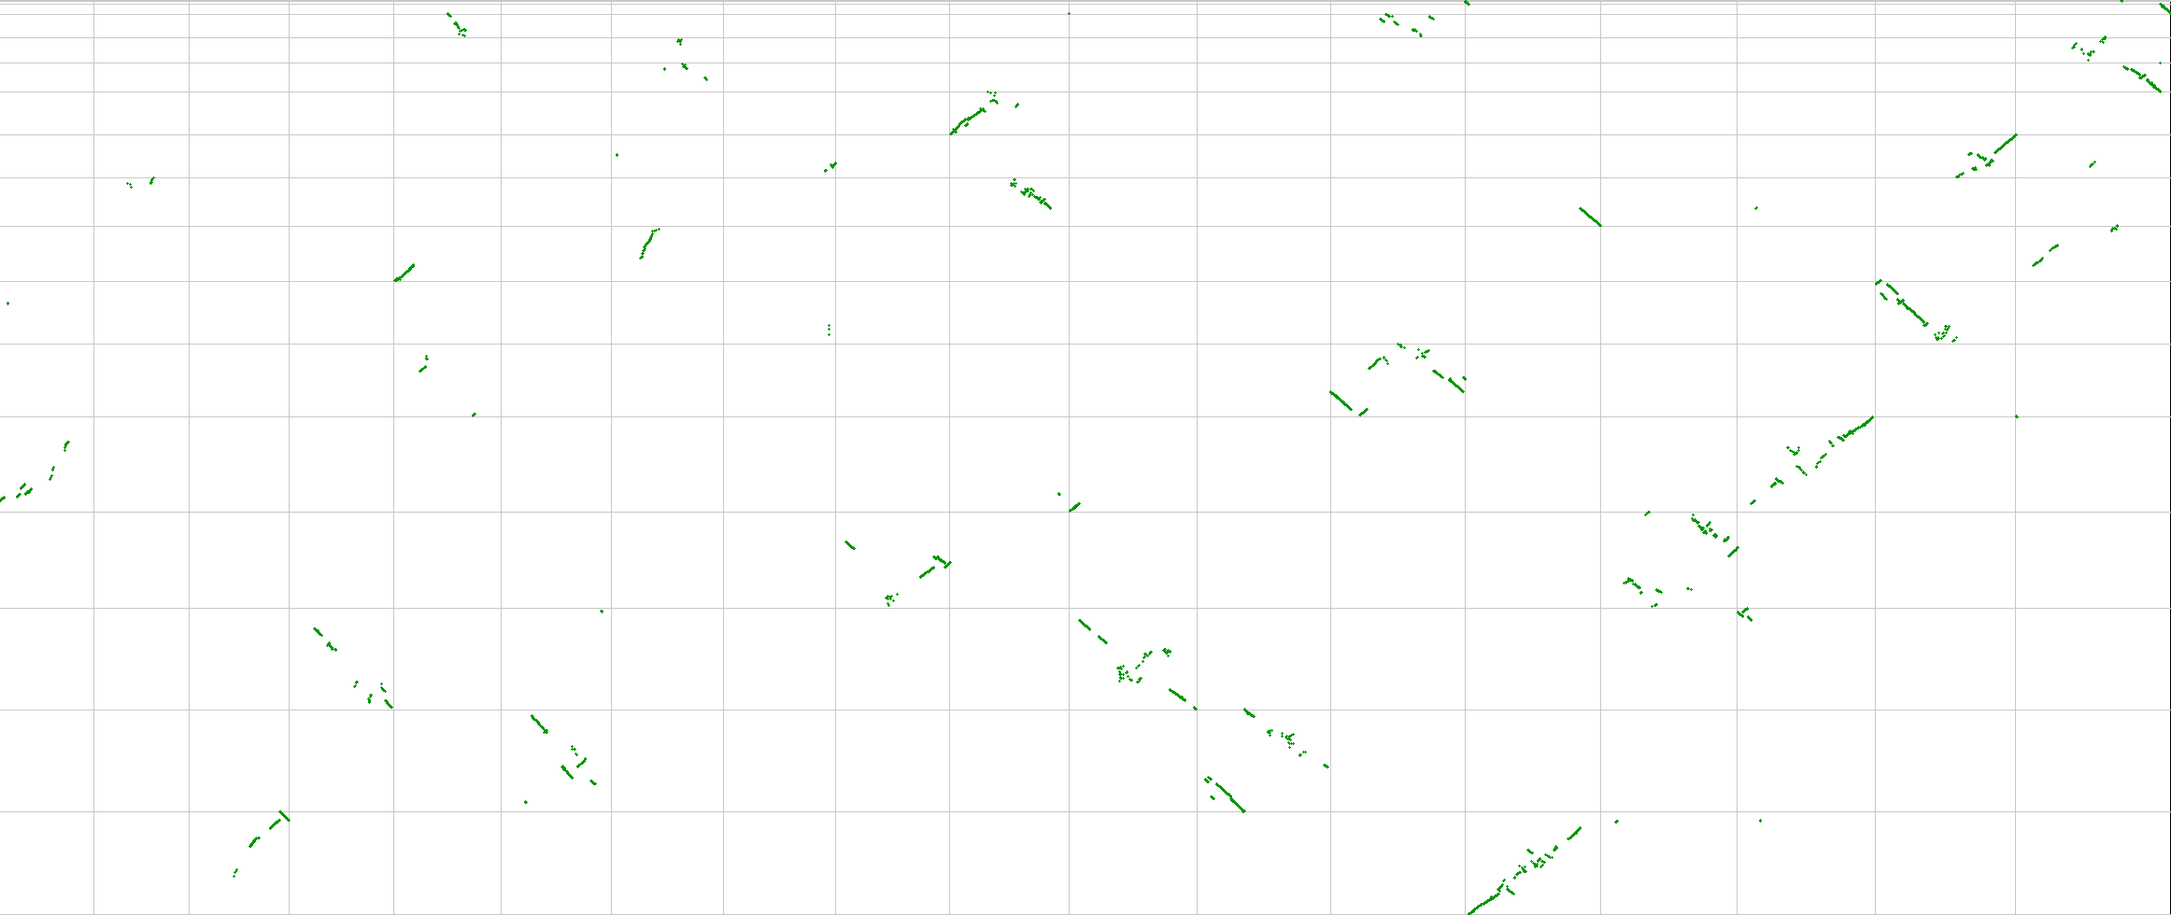
Synteny with C. suecicum
AA
BB
BB
0 1 2 3 4 5 6 7 8
17 16 15 14 13 12 11 10 9 8 7 6 5 4 3 2 1 0

Slide 17
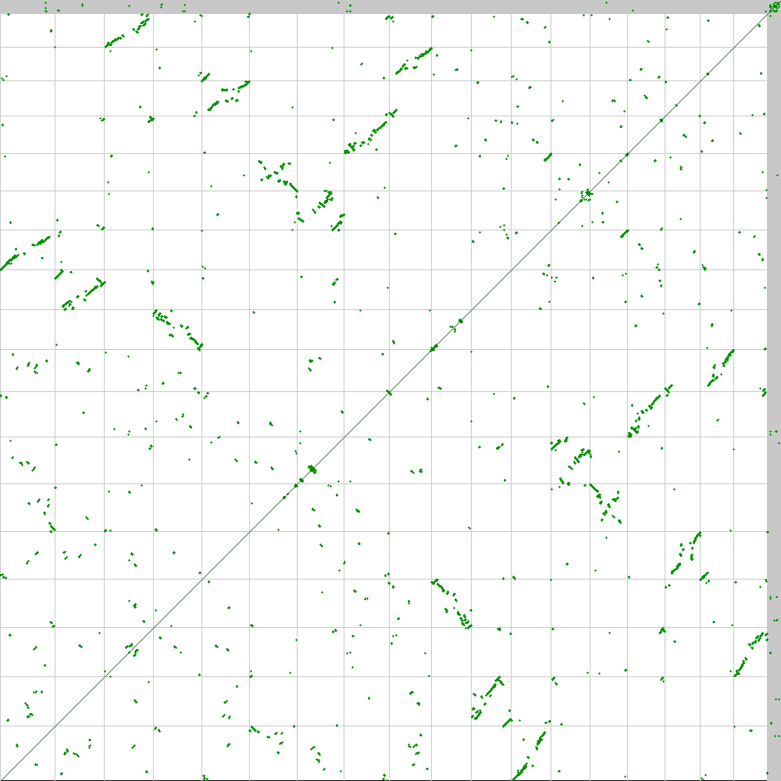
Synteny with Self
0 1 2 3 4 5 6 7 8 9 10 11 12 13 14 15 16 17
Homeologous pairs between the A and B genomes:
0 with 11
1 with 10
2 with 17
3 with 9
4 with 15
5 with 13
6 with 12
7 with 14
8 with 16
0 1 2 3 4 5 6 7 8 9 10 11 12 13 14 15 16 17

Slide 18
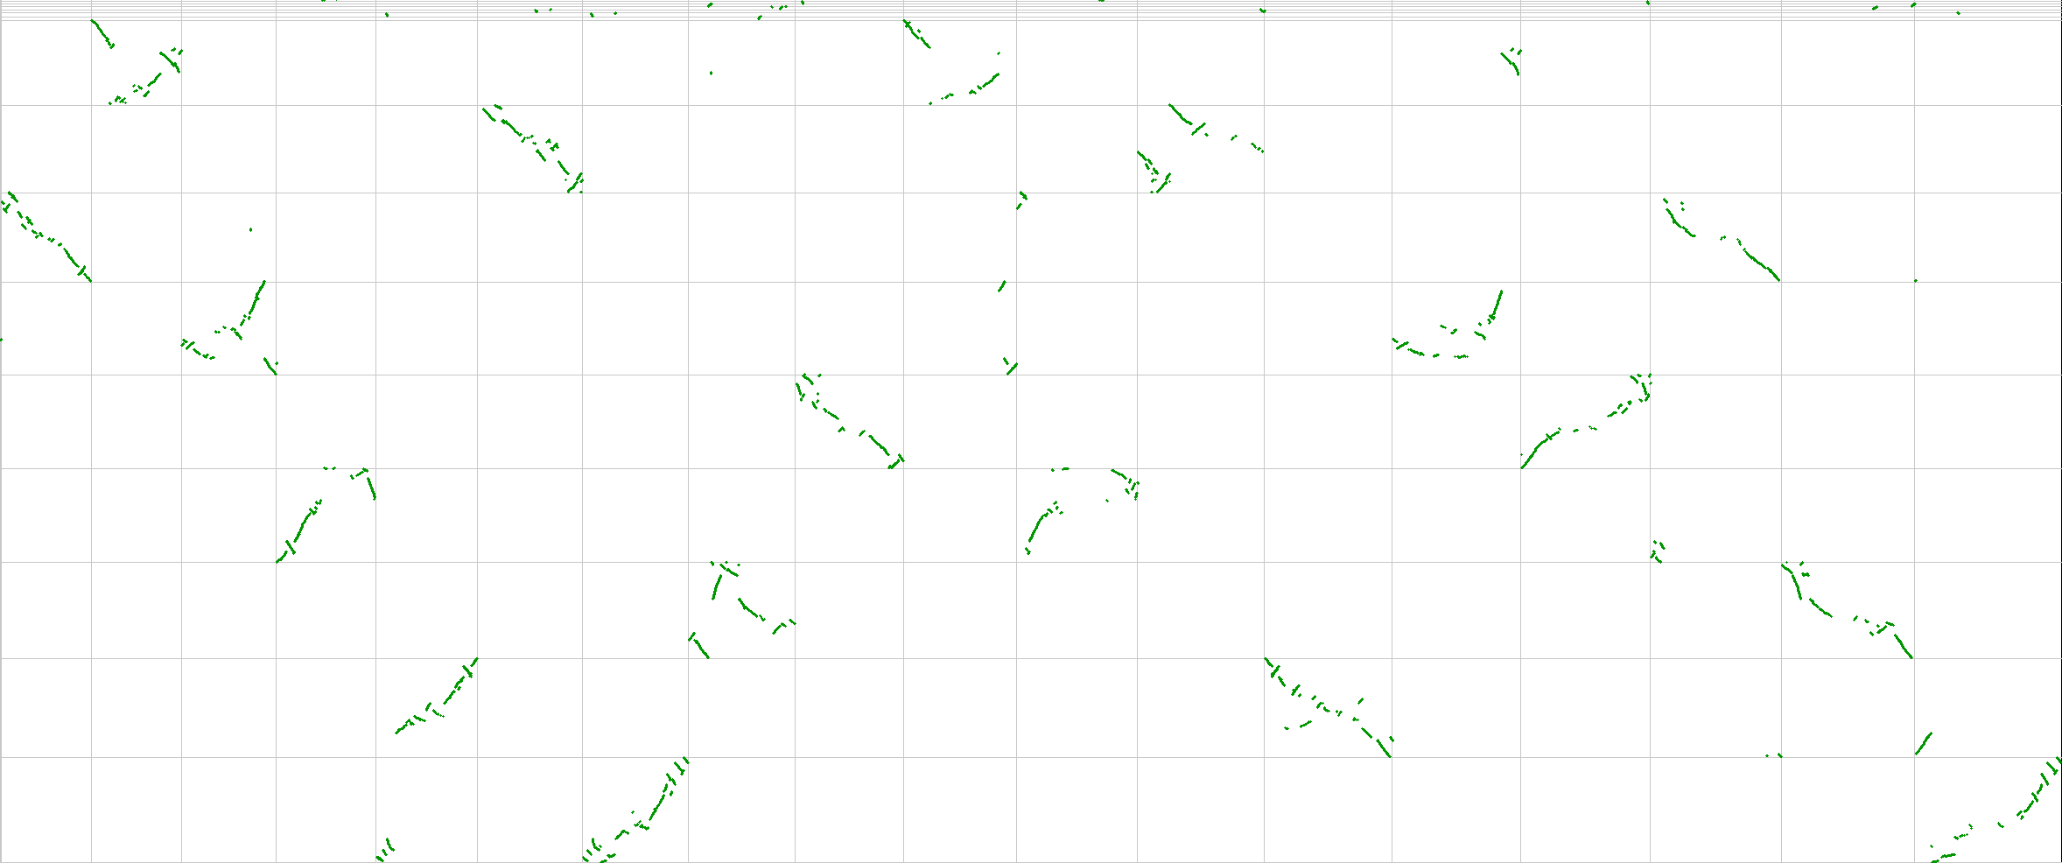
Synteny with Beta vulgaris
Renaming C. berlandieri chromosomes:
AA
BB
B. Vulgaris | AA Scaffold # | AA New Name | BB Scaffold # | BB New Name
1 | 14 | Cb1A | 7 | Cb1B
2 | 17 | Cb2A | 2 | Cb2B
3 | 12 | Cb3A | 6 | Cb3B
4 | 13 | Cb4A | 5 | Cb4B
5 | 10 | Cb5A | 1 | Cb5B
6 | 11 | Cb6A | 0 | Cb6B
7 | 15 | Cb7A | 4 | Cb7B
8 | 9 | Cb8A | 3 | Cb8B
9 | 16 | Cb9A | 8 | Cb9B
6 4 5 1 8 7 2 3 9
17 16 15 14 13 12 11 10 9 8 7 6 5 4 3 2 1 0

Slide 19
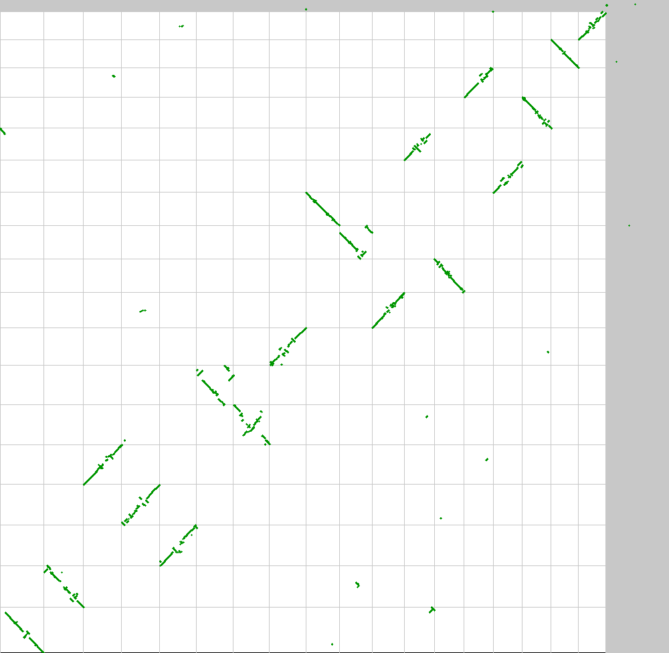
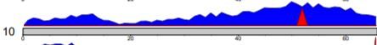
Synteny with C. quinoa
C. quinoa
6B 5B 7B 8B 2B 3B 4B 1B 6A 5A 9B 4A 8A 7A 3A 1A 9A 2A
C. berlandieri
6B 5B 2B 8B 7B 4B 3B 1B 9B 8A 5A 6A 3A 4A 1A 7A 9A 2A
Potential chromosomal rearrangement or
Mis-assembly
Potential chromosomal rearrangement or
Mis-assembly
Notes:
65810

Slide 20
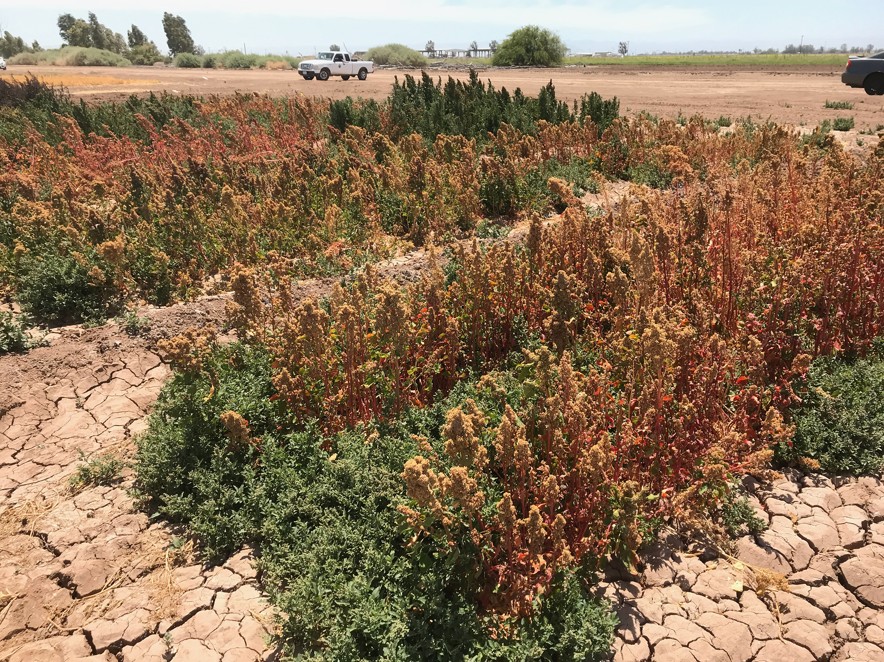
Future Work
Isolate genes
Salinity
Heat
Domestication
Make crosses between C. quinoa and C. berlandieri

Slide 21
Acknowledgments
David Jarvis PhD
Jeff Maughan PhD
Eric Jellen PhD
Phase Genomics

